Slide 1
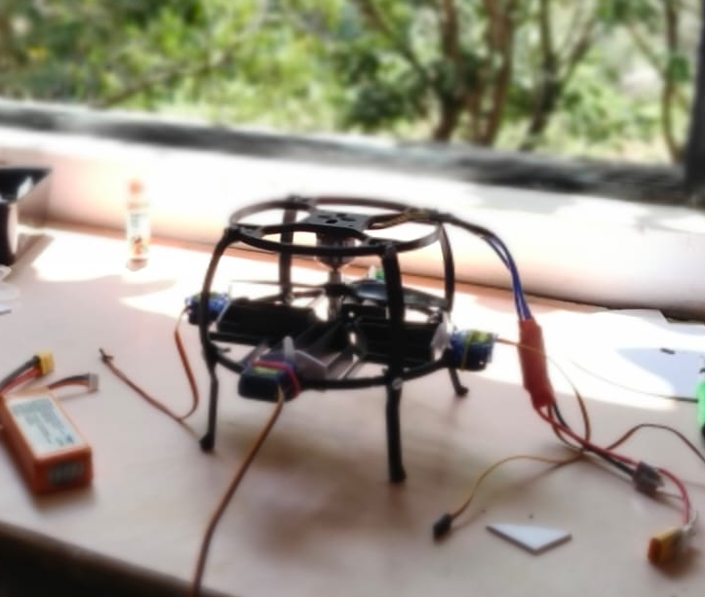
MONOCOPTER
Single-Blade Rotary-Wing UAV with Autonomous Stabilization
ESP32 + MPU6050 | Phase-Locked Cyclic Control
Siddhant Satote • Sanika Nikumbh Department of Electronics & Telecommunication Alard College of Engineering & Management, Pune
GUIDE Prof. Dalvi Sir
Academic Year 2026–27

Slide 2
🍁
⚙️
INTRO-
DUCTION
Bio-Inspired Design
Single Motor Architecture
Rooted in autorotation & gyroscopic dynamics of samaras
One BLDC motor — drastically fewer failure points vs quadcopters
What is a Monocopter?
🎯
📡
Inspired by the maple seed (samara), a monocopter achieves flight using a single rotating wing — the entire airframe spins as one unit.
Core Challenge
Applications
Phase-locked cyclic control — servo must fire at exact rotational phase
Recon, emergency drops, indoor exploration, payload delivery

Slide 3
SYSTEM ARCHITECTURE
POWER
SENSING
COMPUTE
ACTUATION
3S LiPo 11.1V
1300–2200mAh
MPU6050 IMU
6-DOF @ 50Hz I2C
ESP32 240MHz
PID + Phase Track
BLDC Motor + ESC
9g Servo Cyclic Pitch
CONTROL LOOP (50 Hz Fixed-Frequency)
① IMU Data
Acquisition
② Attitude
Estimation
③ Phase
Tracking
④ PID
Computation
⑤ Phase
Match?
⑥ Servo
Actuation

Slide 4
HARDWARE IMPLEMENTATION
ESP32 Dev Board
MPU6050 IMU
Brushless Motor
Flight Controller
Attitude Sensing
Primary Lift / Rotation
240MHz Dual-Core
WiFi / Bluetooth
6-DOF MEMS
50Hz, I2C 400kHz
BLDC, KV TBD
3-Phase AC
ESC
9g Micro Servo
3S LiPo Battery
Motor Speed Control
Phase-Gated Correction
Power Supply
20–30A PWM Input
Throttle Control
PWM Actuation
Cyclic Pitch Control
11.1V, 1300–2200mAh
Main Power Source

Slide 5
PHASE-LOCKED CYCLIC CONTROL
01
The Core Problem
FIRMWARE MODULES
Since the entire airframe rotates, a fixed correction command changes direction each revolution. Control must be phase-aware.
IMU Driver
I2C, DMP init
Attitude Est.
98% gyro + 2% accel
02
Phase Tracking
Phase Tracker
ωz integration
Gyro yaw rate is integrated each 50Hz tick to accumulate rotation angle (0°–360°).
PID Controller
Roll + Pitch error
03
Servo Driver
Phase-gated PWM
PID Output → Direction
Roll + Pitch error determines the target actuation angle. 90° phase lead is added to compensate for gyroscopic lag.
ESC Driver
Throttle PWM
WebSocket
Live telemetry
04
Servo Pulse
When current phase = θ_target + 90°, servo fires a cyclic pitch pulse — once per revolution.

Slide 6
RESULTS & FUTURE SCOPE
50Hz
<5ms
2–3 rev
98/2
IMU data rate
via I2C
Phase tracking
latency
Disturbance
recovery
Gyro/Accel
filter ratio
KEY OBSERVATIONS
FUTURE SCOPE
✓ Phase-locked cyclic control validated in tethered bench testing
🚁 Free Flight Testing
✓ 90° gyroscopic phase lead correctly compensates precession lag
📍 GPS + Barometric Altitude Hold
✓ Complementary filter tuned to 98% gyro weight to reduce vibration noise
🤖 AI Route Optimization
✓ ESP32 dual-core: control loop + telemetry run concurrently
📦 Payload Bay for Drop Missions
🔗 Nexus TVC Firmware Integration
Alard College of Engineering & Management | ENTC Dept | AY 2026–27

Slide 7
